Slide 1



Road Lane Line Detection

Slide 2
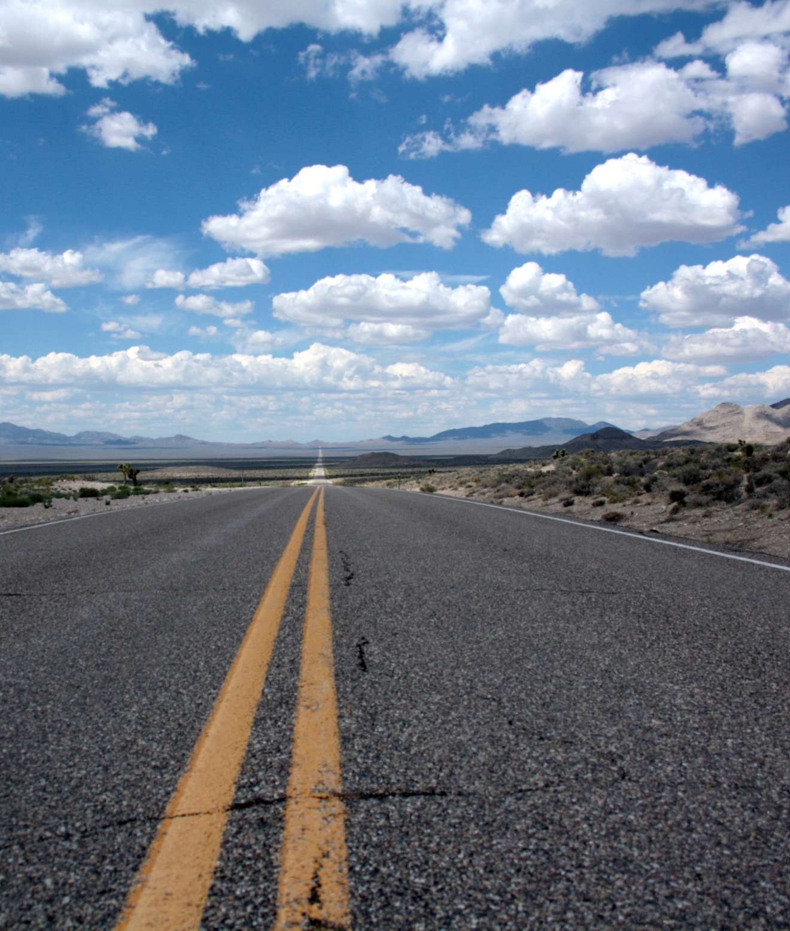


INSTRUCTOR:SIR AMMAR AJMAL
Arhama Haleem
Muhammad Wasif Ijaz

Slide 3



Problem Statement
Identifying lanes on the road computer vision techniques

Slide 4

Project Objectives
The objective of this project is to develop a pipeline using python and “Open-Source Computer Vision” techniques to detect lane lines in images and predict the lanes for driving of the self-driving cars.

Slide 5
STEP 2
STEP 3
STEP 1
Then average/extrapolate them and draw them onto the image for display
Once you have a working pipeline, try it out on the video stream below.
Piece together a pipeline to detect the line segments in the image.

Slide 6

Work Process
Import Packages
Read in an Image
Test Images
Build a Lane Finding Pipeline

Slide 7
cv2.inRange() for color selection
cv2.addWeighted() to coadd / overlay two images
OpenCV functions
cv2.fillPoly() for regions selection
cv2.cvtColor() to grayscale or change color
cv2.line() to draw lines on an image given endpoints
cv2.imwrite() to output images to file
cv2.bitwise_and() to apply a mask to an image

Slide 8
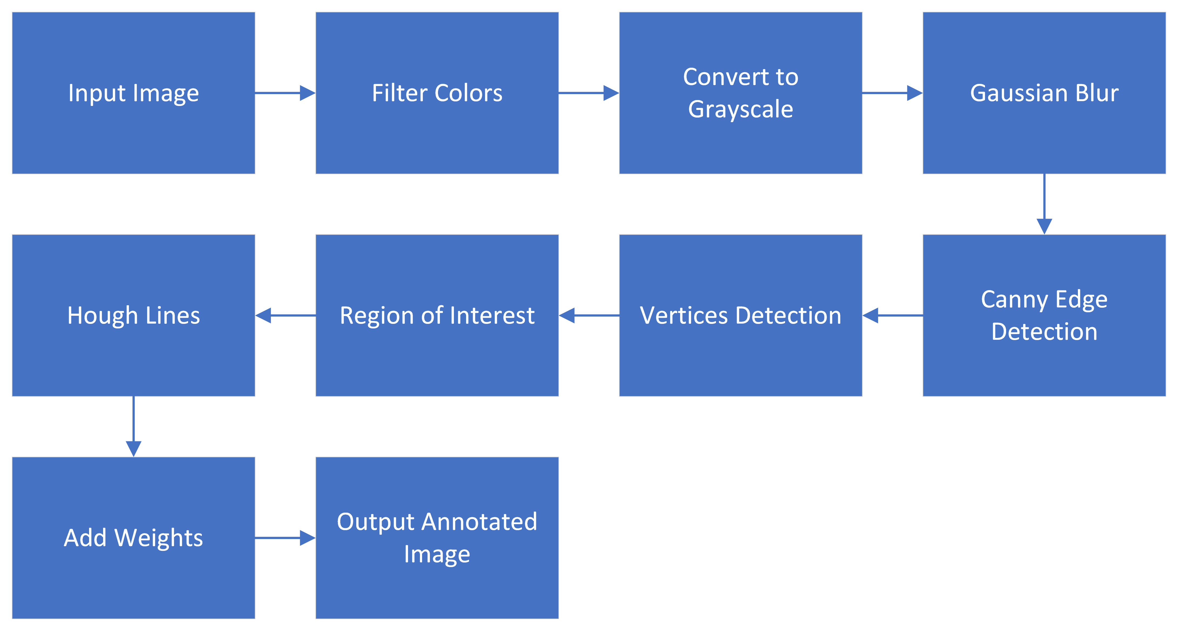
Project Pipeline

Slide 9
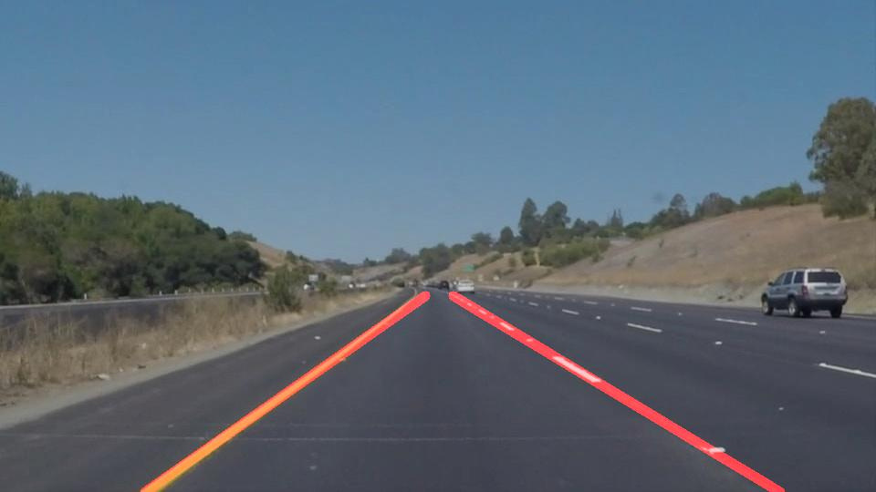
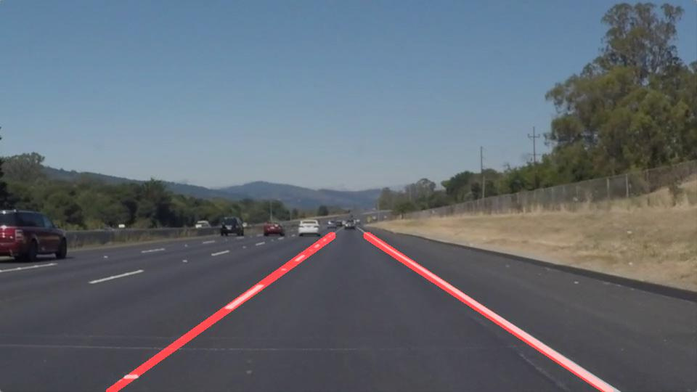
This is our final output picture with line detaction

Slide 10

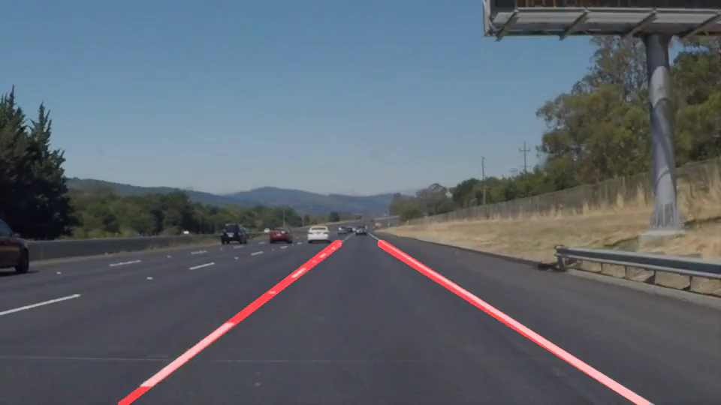
Video

Slide 11


